Slide 1
IBM DATA SCIENCE CAPSTONE PROJECT

Slide 2
HELLO!
I am Parneet Kaur
I am here to discuss my Data Science Capstone project. This presentation is a part of my IBM professional certification course from IBM and Coursera.

Slide 3
Business Problem
Let’s suppose if I am living in US, I want to go to good Indian restaurants in the major cities to hang out with my family near me. Of course, I’ll search it on maps. So, let’s analyze this further that how maps are created !

Slide 4
“We cannot solve problems with the same thinking we used when we created them.”
-Albert Einstein

Slide 5
How to solve our Business problem then?
Understand the problem
Methods we require to solve it
Approaches we should take

Slide 6
Data Analysis
The solution to our Business Problem.

Slide 7

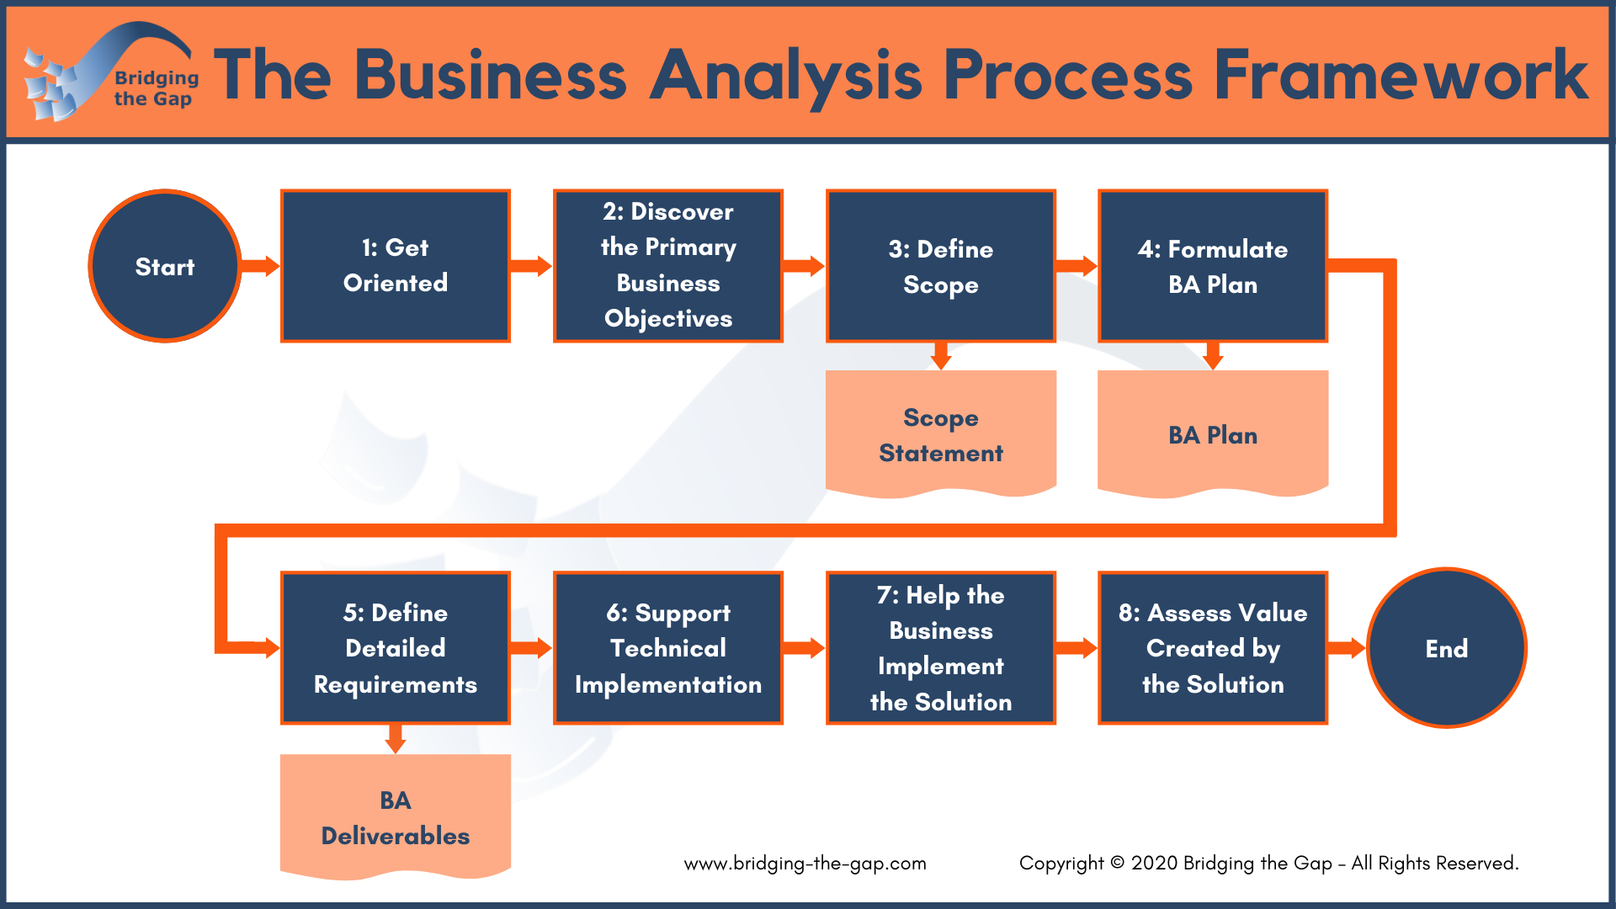
A picture is worth a thousand words
A complex idea can be conveyed with just a single still image, namely making it possible to absorb large amounts of data quickly.

Slide 8
I have used Python 3.7 in Jupyter Notebook.
Used Foursquare API for locations
Folium library to plot maps
Geocoders to locate the coordinates and find our places

Slide 9
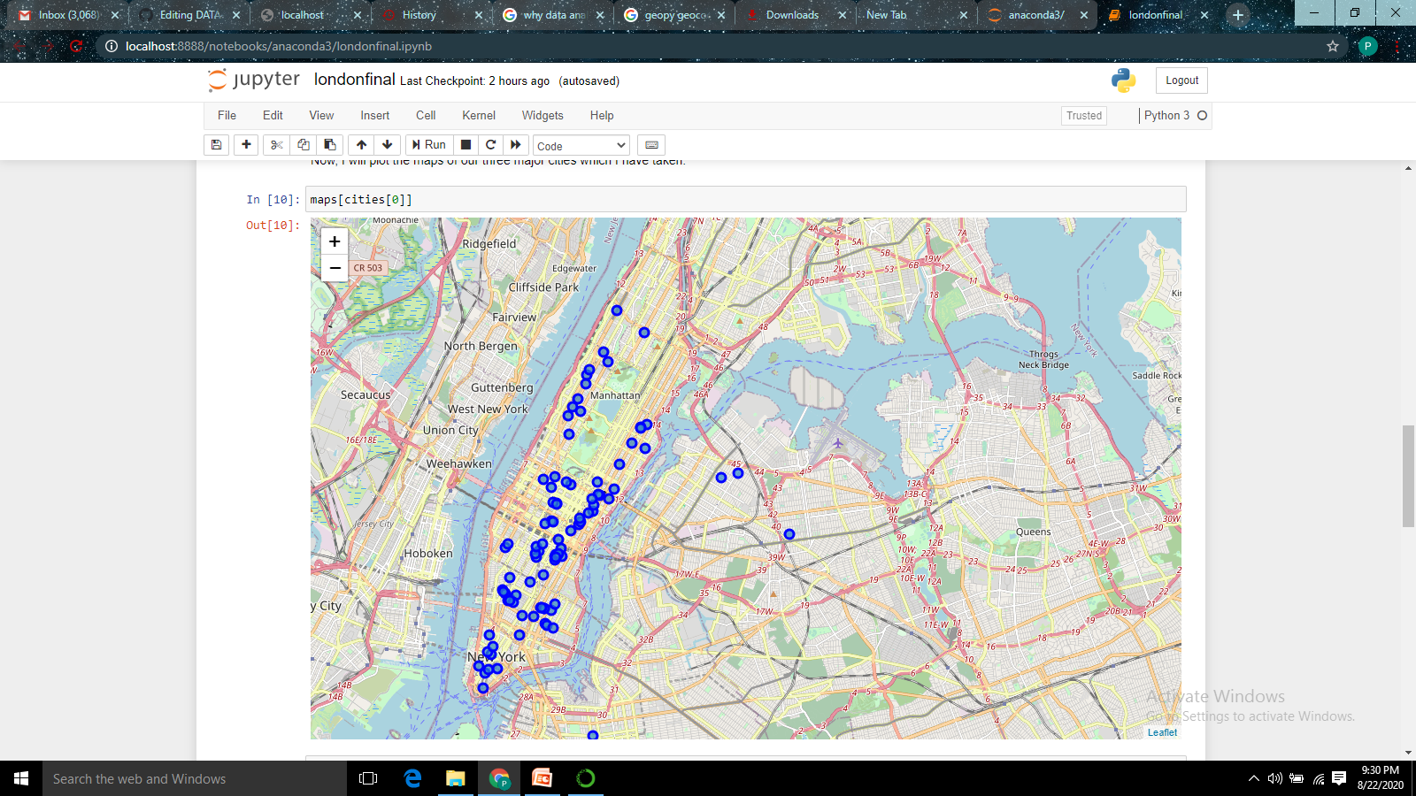
Map of New York showing Indian restaurants.

Slide 10
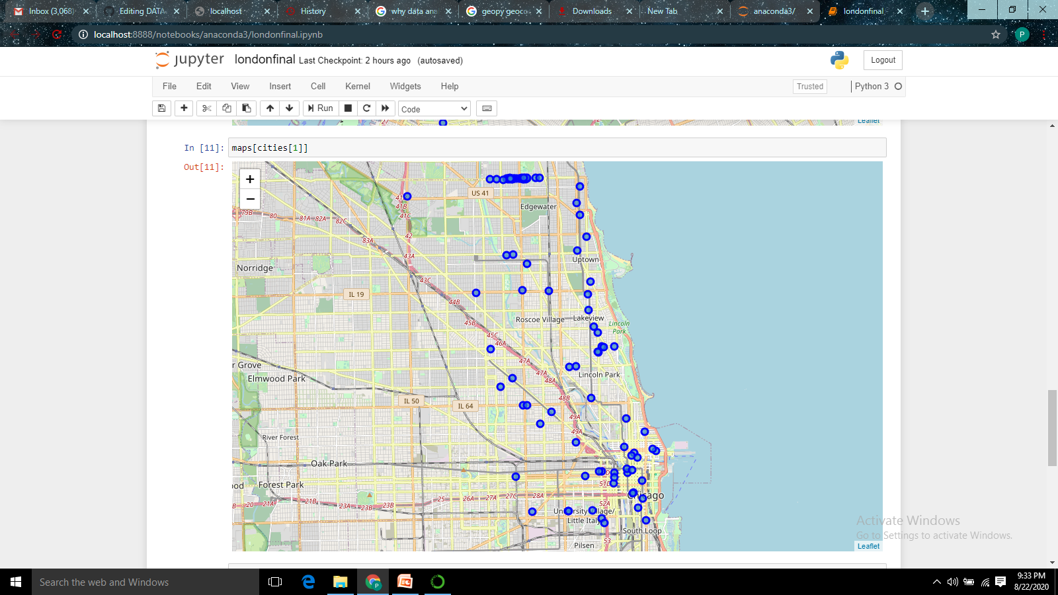
Map of Chicago showing Indian restaurants.

Slide 11
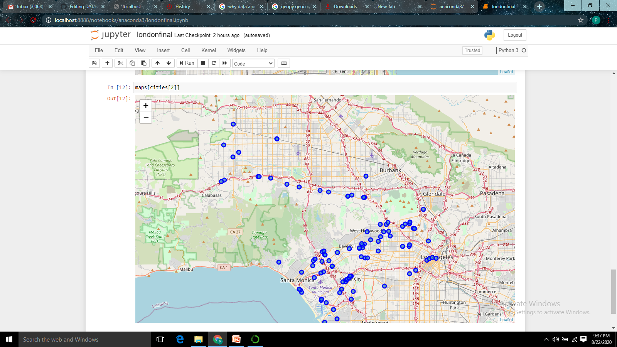
Map of Los Angeles showing Indian restaurants.

Slide 12
Conclusions
There are a variety of Indian restaurants in the major cities of USA i.e. New York, Chicago & Los Angeles and one can easily find these and choose a particular restaurant according to our need.

Slide 13


THANKS!
Any questions?
You can find me at:
@parneetcor
parneetpk@gmail.com

